Slide 1
Notes:
1

Slide 2
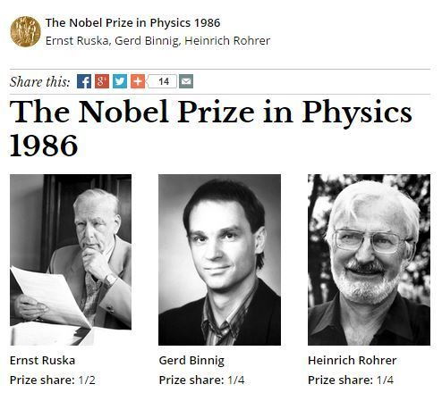
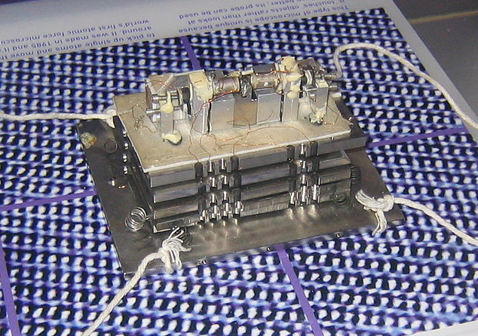
Atomic Force Microscopy and Scanning Probe Microscopy
1981 - Invention of the STM
1986 - Invention of the AFM
Binnig G, Quate CF, Gerber C. Atomic force microscope. Phys. Rev. Lett. 1986 Mar 3;56(9):930-933
Notes:
2

Slide 3
Atomic Force Microscopy and Scanning Probe Microscopy
Probe
Surface
Notes:
3

Slide 4
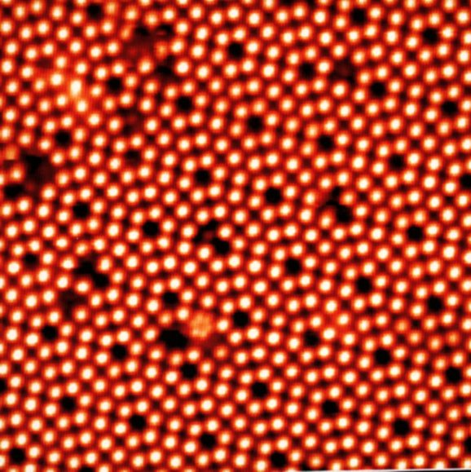
Atomic Force Microscopy and Scanning Probe Microscopy
STM (Scanning tunneling microscope)
Probe
Probe
Electrons
Surface
Surface
Notes:
4

Slide 5
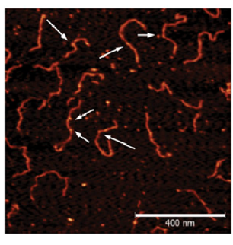
Atomic Force Microscopy and Scanning Probe Microscopy
STM (Scanning tunneling microscope)
AFM (Atomic Force Microscope)
Probe
Force
Surface
Surface
Puranik et al. Plant Cell, 2014
Notes:
5

Slide 6
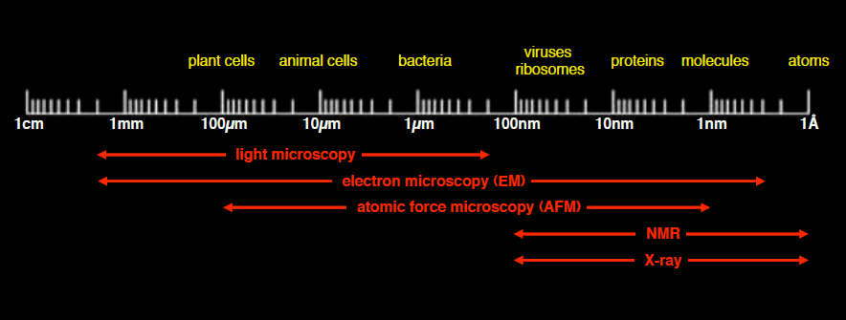
Techniques in Structural Biology
Dimensions in life science – what technique is appropriate
S. Scheuring, AFMBioMed Summer School, Marcoule 2011
Notes:
6

Slide 7
Techniques in Structural Biology
Dimensions in life science – what technique is appropriate
S. Scheuring, AFMBioMed Summer School, Marcoule 2011
LENGHTSCALE
TIMESCALE
Notes:
7

Slide 8
Outline
1) Introduction to Scanning Probe Microscopy
2) The Force
3) Methods
Cantilevers
Static and Dynamic AFM
4) Instruments
5) Advanced and novel AFM methods
Notes:
8

Slide 9

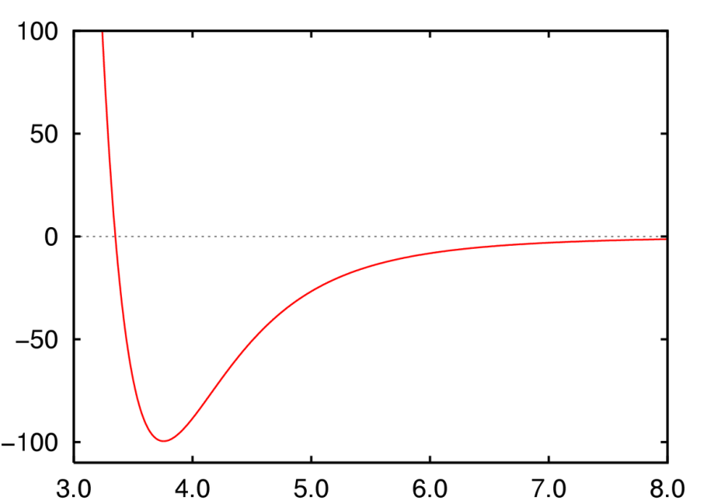
Interaction Forces at nanoscale
Force
Repulsive
Force
Tip-sample distance
Repulsion due to overlap of
tip-sample
electronic shells
Notes:
9

Slide 10
Interaction Forces at nanoscale
Force
Attractive
Force
Tip-sample distance
Attraction due to
Van der Waals, capillarity….
Notes:
10

Slide 11
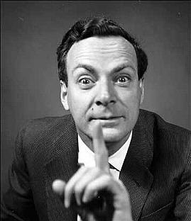
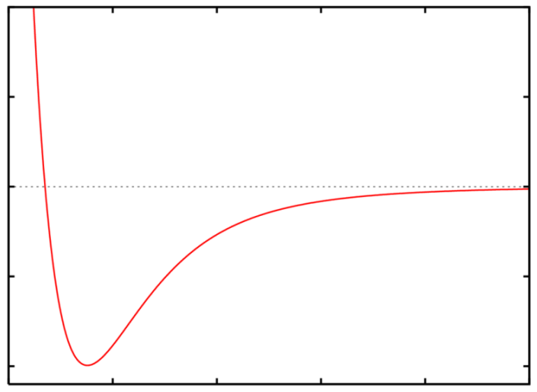
Interaction Forces at nanoscale
Richard P.
Feynman
(1918 – 1988)
“… If, in some cataclysm, all of scientific knowledge were to be destroyed, and only one sentence passed on to the next generations of creatures, what statement would contain the most information in the fewest words? I believe it is the atomic hypothesis (or the atomic fact, or whatever you wish to call it) that all things are made of atoms—little particles that move around in perpetual motion, attracting each other when they are a little distance apart, but repelling upon being squeezed into one another...”
Notes:
11

Slide 12
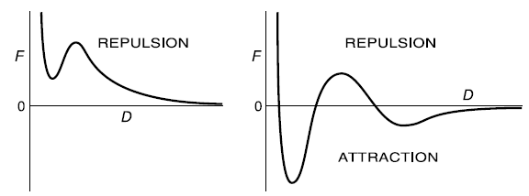
Interaction Forces at nanoscale
Tip sample Interaction Force depends on
Tip and sample geometry
Tip and sample nature (chemical affinity, charges)
Tip and/or Sample stiffness
Environment (liquid, air, gas, vacuum)
Notes:
12

Slide 13
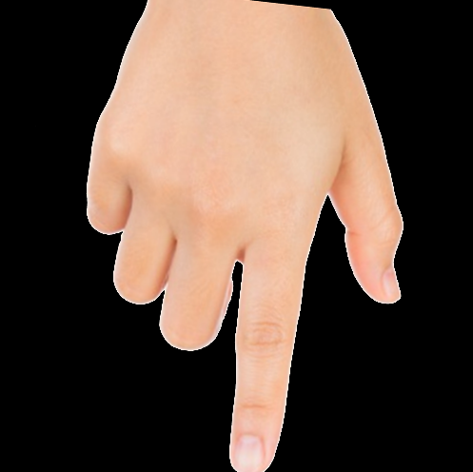
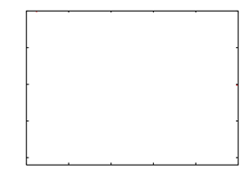
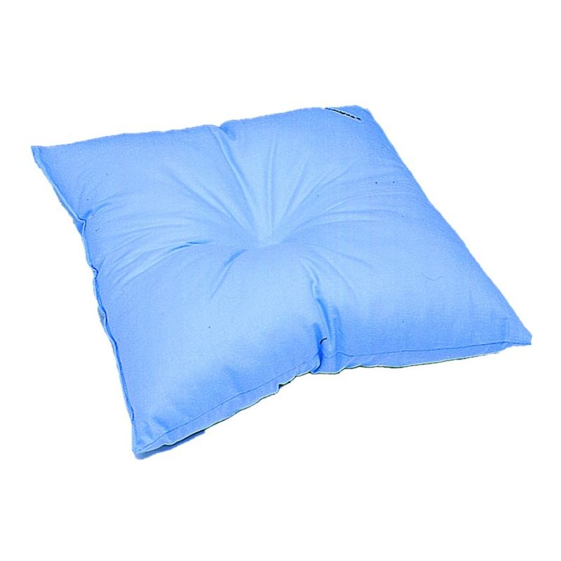
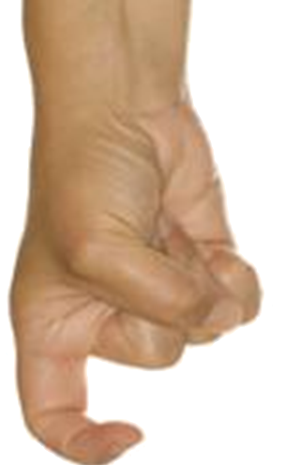
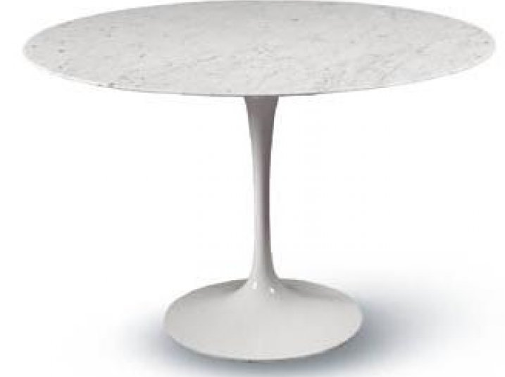
Interaction Forces at nanoscale
Tip and/or Sample stiffness
SOFT
Force
Tip-sample distance
SOFT
Force
RIGID
Tip-sample distance
Notes:
13

Slide 14
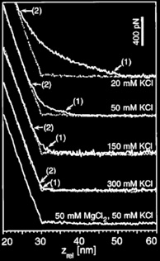
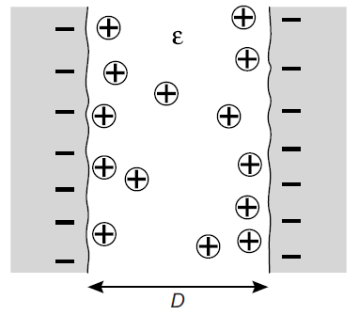
Interaction Forces at nanoscale
Tip and/or Sample stiffness
Environment: liquid + salt
SOFT
Force
IONS ARE
IMPORTANT!!!
Tip-sample distance
SOFT
Force
RIGID
Daniel J Müller, Dimitrios Fotiadis, Simon Scheuring, Shirley A Müller & Andreas Engel Electrostatically balanced subnanometer imaging of biological specimens by atomic force microscopy Biophys J, 1999, 76 (2): 1101-1111
Tip-sample distance
Notes:
14

Slide 15
Outline
1) Introduction to Scanning Probe Microscopy
2) The Force
3) Methods
Cantilevers
Static and Dynamic AFM
4) Instruments
5) Advanced and novel AFM methods
Notes:
15

Slide 16
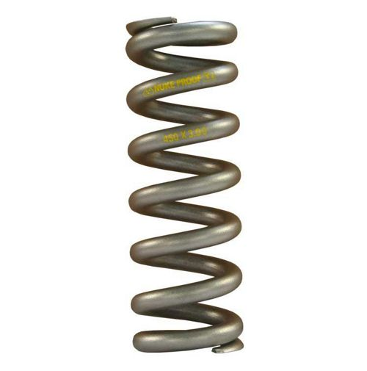
Cantilevers
Cantilever
Stiffness k
=
Mass m
Force
Force
Sample
Sample
Notes:
16

Slide 17
Cantilevers
Mass m
Mass m
Attractive
Force
Tip-sample distance
Notes:
17

Slide 18
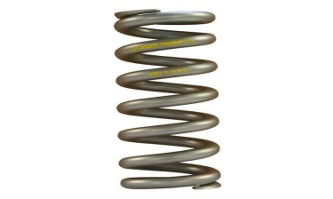
Cantilevers
Mass m
Mass m
Repulsive
Force
Tip-sample distance
Notes:
18

Slide 19
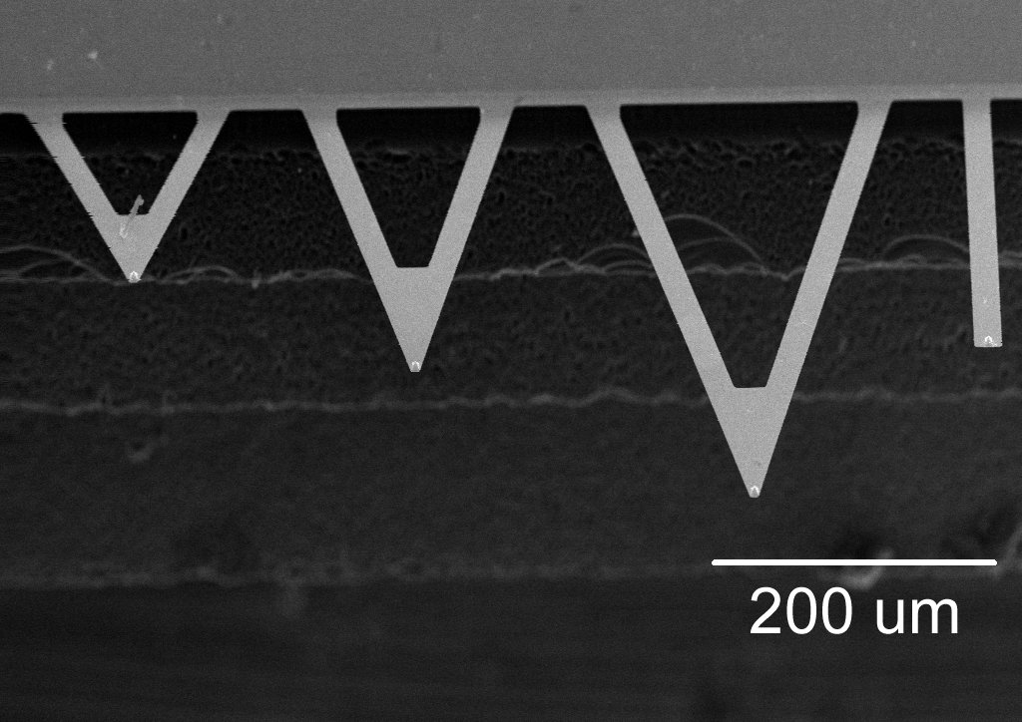
Cantilevers
Top view
Stiffness k
Mass m
Side view
Force
Notes:
19

Slide 20
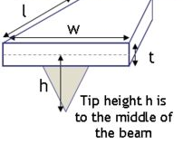
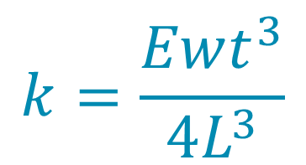
Cantilevers
Stiffness k: from 0.006 N/m to 100 N/m
Extrinsic property
$$k=\frac{Ewt^{3}}{4L^{3}}$$
k must be
calibrated !!
E = Young’s modulus [Pa] intrinsic property
Length L: from 10 µm to 500 µm
Materials: Silicon and Silicon Nitride
Notes:
20

Slide 21

Cantilevers and harmonic oscillators
$$mz+δz+kz=Finteraction\left(z\right)+F0(ωt)$$
Z
$$F0$$
Damping δ [N s /m]: environment, viscosity
Stiffness k [N/m]
m
Mass m [Kg]
F_{interaction} [N]
Notes:
21

Slide 22
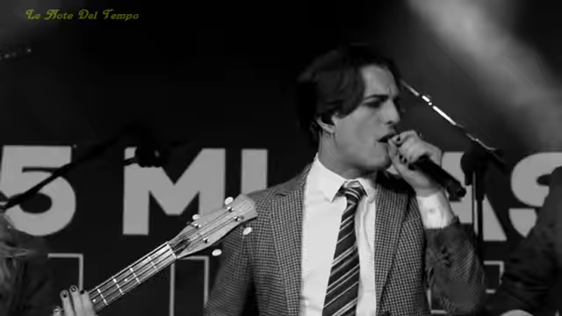
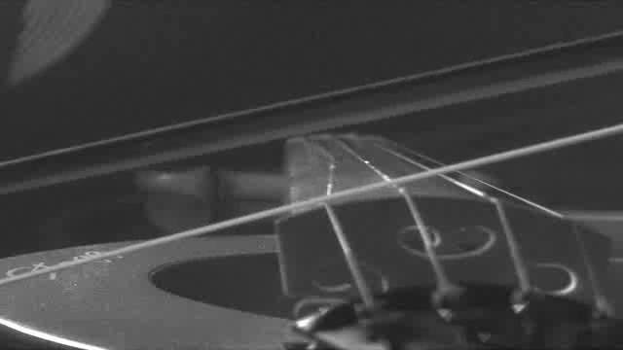

Cantilevers and harmonic oscillators
$$mz+δz+kz=Finteraction\left(z\right)+F0(ωt)$$
Z
$$F0$$
Damping δ [N s /m]: environment, viscosity
Stiffness k [N/m]
m
Mass m [Kg]
F_{interaction} [N]
Notes:
22

Slide 23

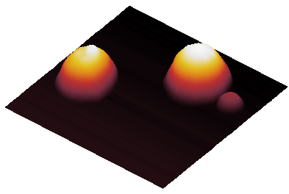
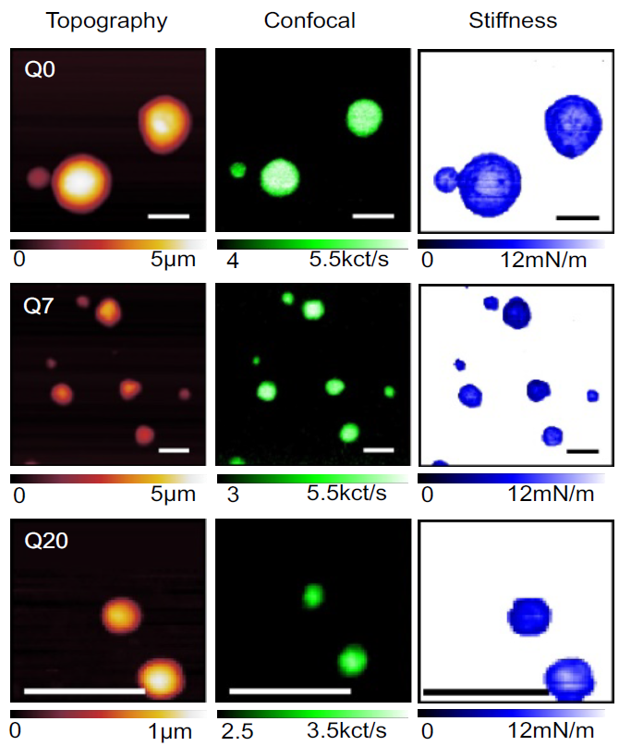
IMAGE ACQUISITION AND FORCE SPECTROSCOPY
Imaging
Scan
direction
Notes:
23

Slide 24
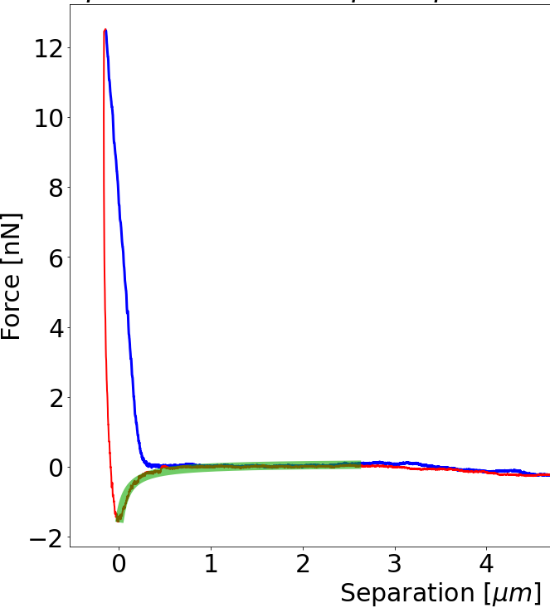

IMAGE ACQUISITION AND FORCE SPECTROSCOPY
Imaging
Force
Spectroscopy
Scan
direction
Separation
Notes:
24

Slide 25
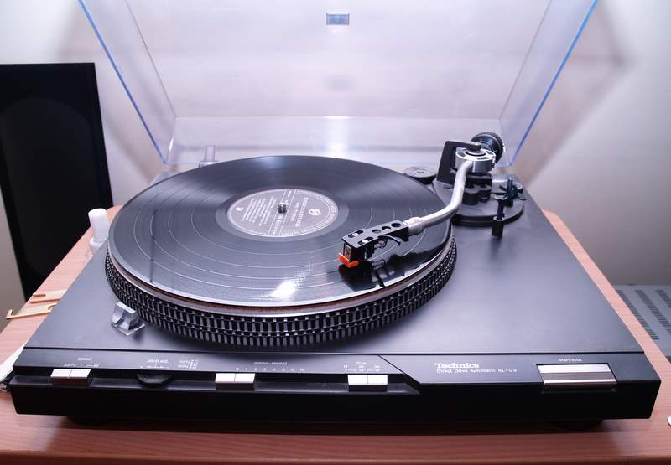
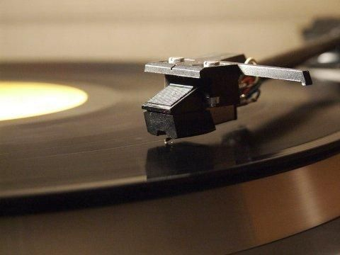
Static AFM mode (contact mode)
STATIC AFM: tip in permanent contact with the sample
Phonograph
Notes:
25

Slide 26
Static AFM mode (contact mode)
STATIC AFM: tip in permanent contact with the sample
Phonograph
Notes:
26

Slide 27
Static AFM mode (contact mode)
STATIC AFM: tip in permanent contact with the sample
Phonograph
Notes:
27

Slide 28
Static AFM mode (contact mode)
STATIC AFM: tip in permanent contact with the sample
Phonograph
Cantilever
deflection
Notes:
28

Slide 29
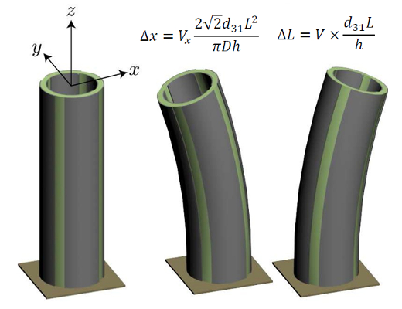
Static AFM mode (contact mode) – The closed loop
PIEZO: X/Y/Z scanner
Scan direction
Cantilever deflection
Z scanner position
Notes:
29

Slide 30
Static AFM mode (contact mode) – The closed loop
PIEZO: X/Y/Z scanner
Cantilever deflection
Z scanner position
Notes:
30

Slide 31
Static AFM mode (contact mode) – The closed loop
PIEZO: X/Y/Z scanner
Cantilever deflection
Z scanner position
Notes:
31

Slide 32
Static AFM mode (contact mode) – The closed loop
PIEZO: X/Y/Z scanner
Cantilever deflection
Z scanner position
Notes:
32

Slide 33
Static AFM mode (contact mode) – The closed loop
PIEZO: X/Y/Z scanner
Cantilever deflection
Z scanner position
Notes:
33

Slide 34
Static AFM mode (contact mode) – The closed loop
Constant
deflection
PIEZO: X/Y/Z scanner
Cantilever deflection
Z scanner position
Notes:
34

Slide 35
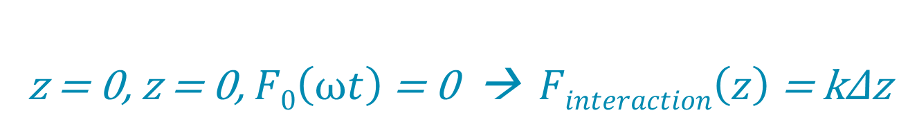
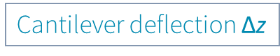
Static AFM mode (contact mode) – Operational scheme
Cantilever deflection $\text{Δ}\text{z}$
Optical
system
Cantilever
Sample
Magic box
X/Y/Z Scanner
$$mz+δz+kz=Finteraction\left(z\right)+F0(ωt)$$
z = 0, z = 0, $F0\left(ωt\right)$ = 0 → $Finteraction\left(z\right)$ = kΔz
Hook
Law
Notes:
35

Slide 36
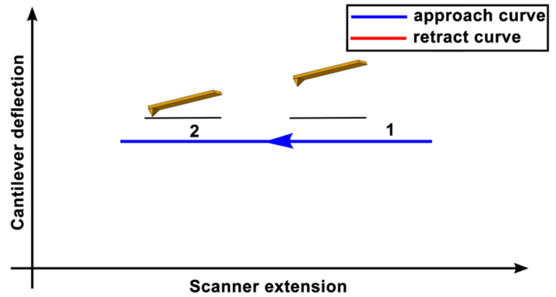
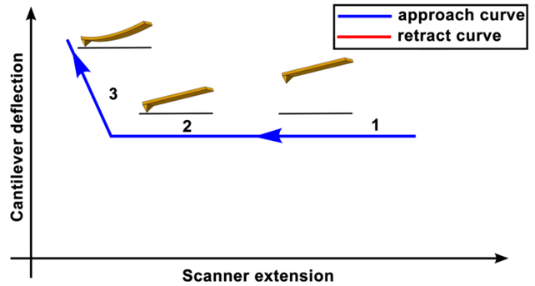
Static AFM mode (contact mode) – Force curves
Δz
Adapted from Polymer Science, Chapter 4, U. Maver et al., Intech, 2013
Notes:
36

Slide 37
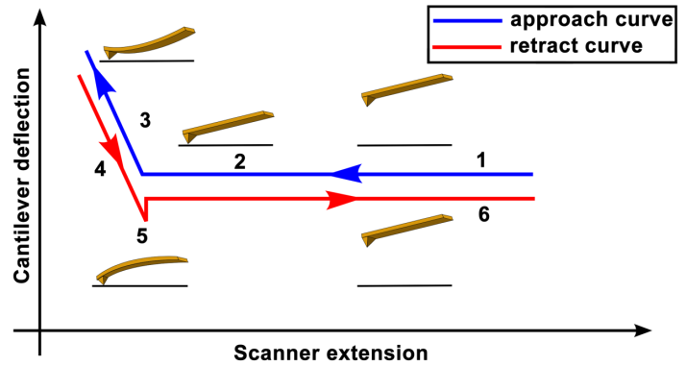
Static AFM mode (contact mode) – Force curves
Δz
Adapted from Polymer Science, Chapter 4, U. Maver et al., Intech, 2013
H.-J. Butt, B. Cappella and M. Kappl,
Surface Science Reports, 59, 1-152, 2005
Notes:
37

Slide 38
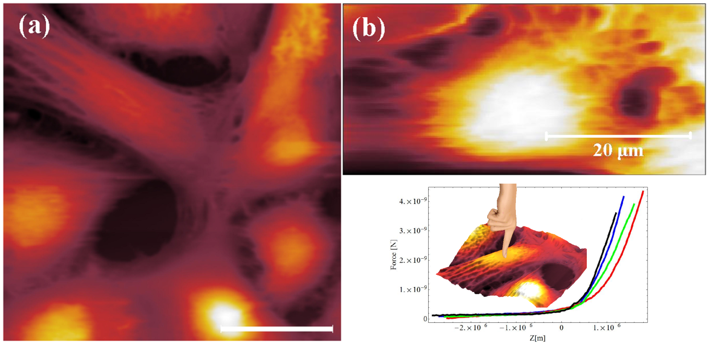
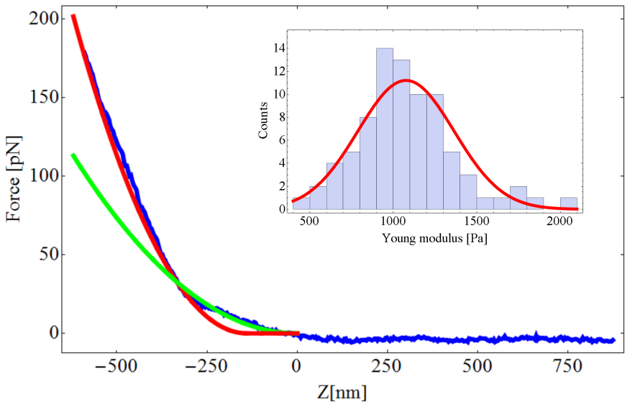
Static AFM mode (contact mode) – Force curves
Costa et al., PLOSONE, 2014
Mechanics
Notes:
38

Slide 39
Static AFM mode (contact mode) – Force curves
Costa et al., PLOSONE, 2014
Mechanics
Ligand
Receptor
Molecular recognition
Notes:
39

Slide 40
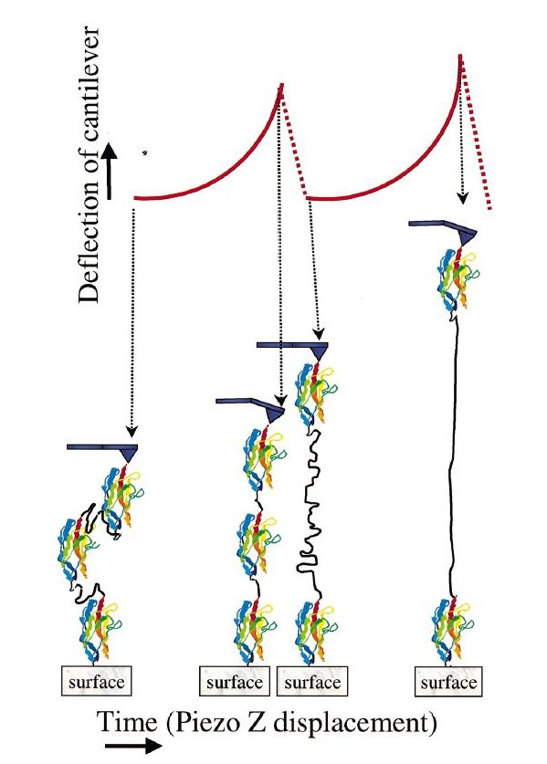
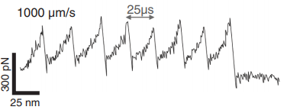
Static AFM mode (contact mode) – Force curves
Costa et al., PLOSONE, 2014
Mechanics
Ligand
Receptor
Molecular recognition
Protein unfolding
Luigi
Bubacco
website
F. Rico et al.
Science,
342(6159),
741-743, 2013
Notes:
40

Slide 41
Outline
1) Introduction to Scanning Probe Microscopy
2) The Force
3) Methods
Cantilevers
Static and Dynamic AFM
4) Instruments
5) Advanced and novel AFM methods
Notes:
41

Slide 42
Dynamic AFM mode (Amplitude Modulation mode) – AM-AFM
$$mz+δz+kz=Finteraction\left(z\right)+F0(ωt)$$
Z
$$F0$$
Damping δ [N s /m]: environment, viscosity
Stiffness k [N/m]
m
Mass m [Kg]
F_{interaction} [N]
Notes:
42

Slide 43
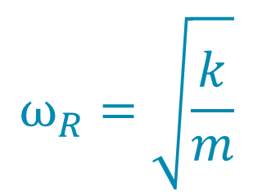
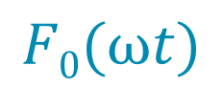

Dynamic AFM mode (Amplitude Modulation mode) – AM-AFM
$$mz+δz+kz=Finteraction\left(z\right)+F0(ωt)$$
Z
$$F0$$
Damping δ [N s /m]: environment, viscosity
Stiffness k [N/m]
m
Mass m [Kg]
F_{interaction} [N]
$$F0(ωt)$$
Resonance frequency
$$ω_{R}=\sqrt{\frac{k}{m}}$$
$$\text{A}$$
Notes:
43

Slide 44
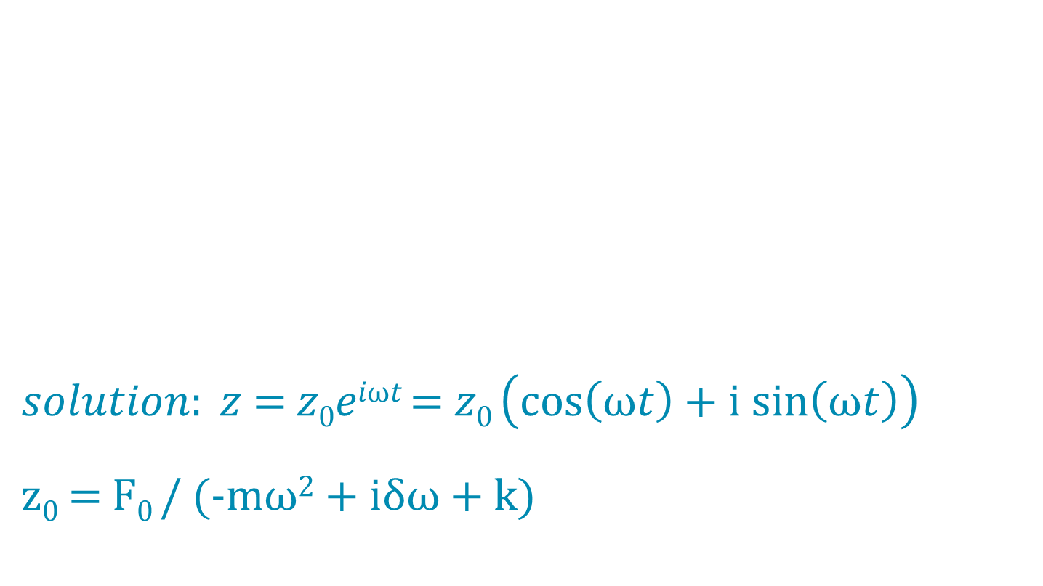
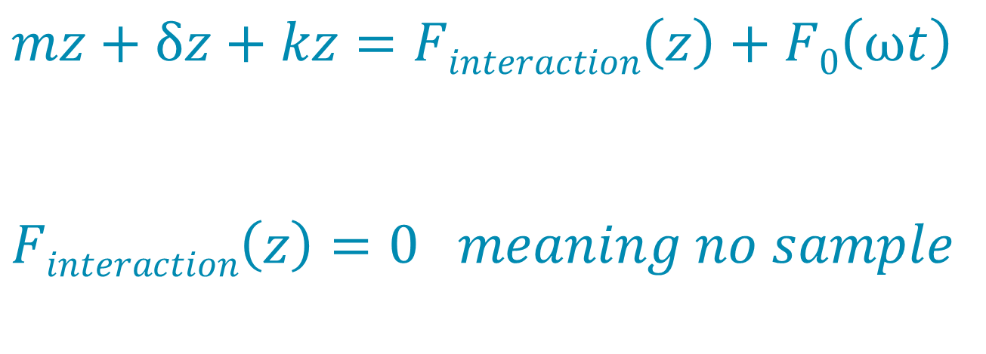
Dynamic AFM mode – Harmonic Oscillator
$solution: z$ = $z0eiωt$ = $z0$ $\left(cos\left(ωt\right)+i sin\left(ωt\right)\right)$
$z0$ = F$0$ / (-mω² + iδω + k)
$$mz+δz+kz=Finteraction\left(z\right)+F0\left(ωt\right)$$
$$Finteraction\left(z\right)=0 meaning no sample$$
Notes:
44

Slide 45
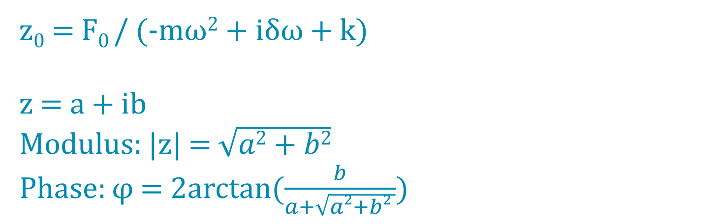
Dynamic AFM mode – Harmonic Oscillator
$z0$ = F$0$ / (-mω² + iδω + k)
z = a + ib
Modulus: |z| = $\sqrt{a2+b2}$
Phase: φ = 2arctan($\frac{b}{a+\sqrt{a2+b2 }}$)
Notes:
45

Slide 46
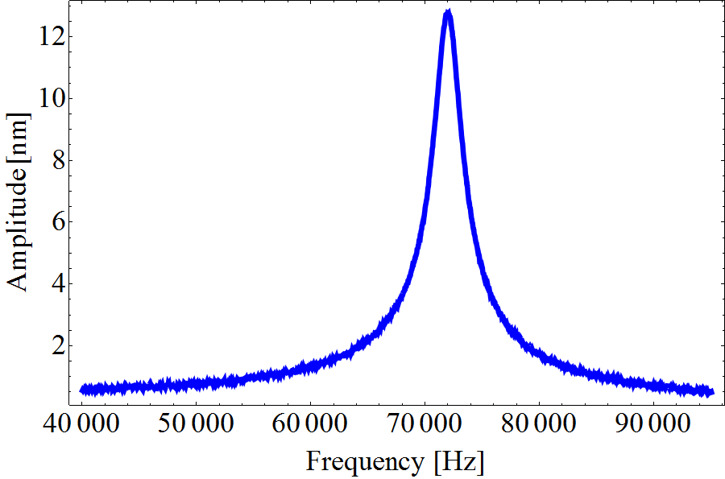
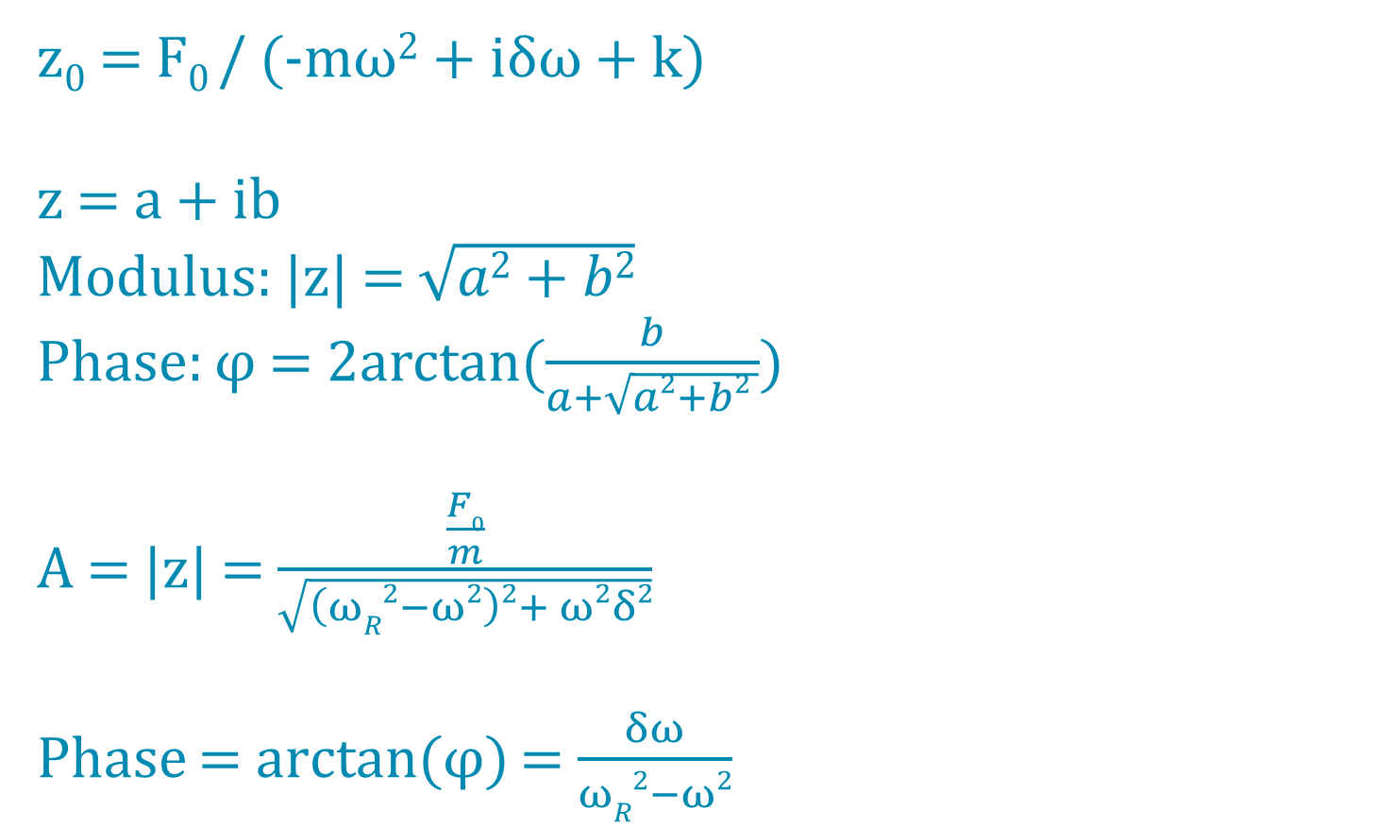
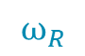
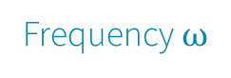
Dynamic AFM mode – Harmonic Oscillator
$z0$ = F$0$ / (-mω² + iδω + k)
z = a + ib
Modulus: |z| = $\sqrt{a2+b2}$
Phase: φ = 2arctan($\frac{b}{a+\sqrt{a2+b2 }}$)
A = |z| = $\frac{\frac{F0}{m}}{\sqrt{\left(ωR2−ω2\right)2+ ω2δ2}}$
Phase = arctan(φ) = $\frac{δω}{ωR2−ω2}$
A = Amplitude
$$ω_{R}$$
Frequency $ω$
Notes:
46

Slide 47
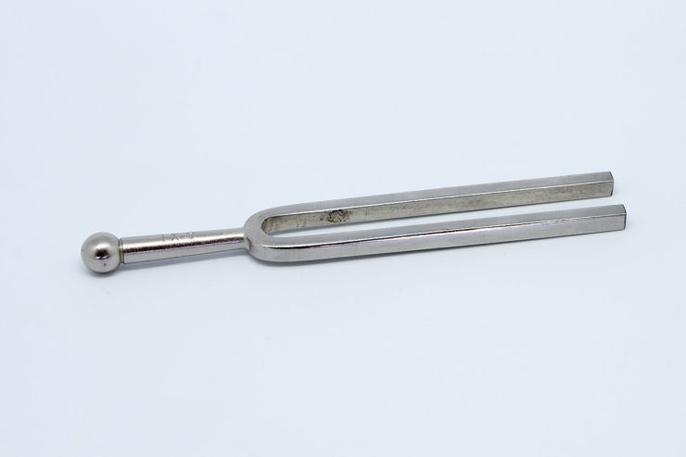

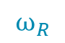
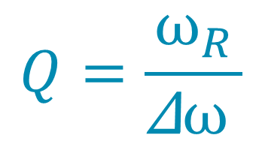


Dynamic AFM mode – Harmonic Oscillator (Q factor)
Q factor
Amplitude
$$Q=\frac{ω_{R}}{\text{Δ}ω }$$
Δ$ω$
$$ω_{R}$$
Frequency $ω$
High Q
Notes:
47

Slide 48



Dynamic AFM mode – Harmonic Oscillator (phase)
At low frequency
E$xcitation$
F
time
Amplitude
A
time
$$ω_{R}$$
Frequency
$ω$
Notes:
48

Slide 49


Dynamic AFM mode – Harmonic Oscillator (phase)
At resonance $ω_{R}$
E$xcitation$
F
time
Amplitude
A
time
$$ω_{R}$$
Frequency
$ω$
Notes:
49

Slide 50

Dynamic AFM mode – Harmonic Oscillator (phase)
After resonance
E$xcitation$
F
time
Amplitude
A
Φ Phase
time
$$ω_{R}$$
Frequency
$ω$
Notes:
50

Slide 51

Dynamic AFM mode (AM-AFM) – Operational scheme
Cantilever amplitude
Optical
system
$$\text{A}$$
Cantilever
Sample
Magic box
Constant
amplitude
X/Y/Z Scanner
Notes:
51

Slide 52





Dynamic AFM mode (AM-AFM) – in liquid, for biology
1) Part of the liquid participates (coupled) to cantilever motion
$$ω_{R}=\sqrt{\frac{k}{m}}$$
$${ω^{′}}_{R}=\sqrt{\frac{k}{m+m_{L}}}$$
$$ω_{R}$$
$${ω^{′}}_{R}$$
Notes:
52

Slide 53
Dynamic AFM mode (AM-AFM) – in liquid, for biology
1) Part of the liquid participates (coupled) to cantilever motion
$$ω_{R}=\sqrt{\frac{k}{m}}$$
$${ω^{′}}_{R}=\sqrt{\frac{k}{m+m_{L}}}$$
$$ω_{R}$$
$${ω^{′}}_{R}$$
2) The resonance gets broader → decrease of Q factor. That’s because water has higher viscosity than air δ_{liquid} > δ_{air}
Notes:
53

Slide 54
Dynamic AFM mode (AM-AFM) – in liquid, for biology
1) Part of the liquid participates (coupled) to cantilever motion
$$ω_{R}=\sqrt{\frac{k}{m}}$$
$${ω^{′}}_{R}=\sqrt{\frac{k}{m+m_{L}}}$$
$$ω_{R}$$
$${ω^{′}}_{R}$$
2) The resonance gets broader → decrease of Q factor. That’s because water has higher viscosity than air δ_{liquid} > δ_{air}
3) When excited mechanically,
the response of the tip is plenty of spurious peaks
Notes:
54

Slide 55
Outline
1) Introduction to Scanning Probe Microscopy
2) The Force
3) Methods
Cantilevers
Static and Dynamic AFM
4) Instruments
5) Advanced and novel AFM methods
Notes:
55

Slide 56
Cantilever deflection measurement
Optical beam deflection
G. Meyer and N. M. Amer, Appl. Phys. Lett. 53, 1045 (1988).
Notes:
56

Slide 57
Cantilever deflection measurement
Optical beam deflection
G. Meyer and N. M. Amer, Appl. Phys. Lett. 53, 1045 (1988).
Notes:
57

Slide 58


Cantilever deflection measurement
Optical beam deflection
G. Meyer and N. M. Amer, Appl. Phys. Lett. 53, 1045 (1988).
DEFL
DEFL$=\frac{\left(A+B\right)−(C+D)}{A+B+C+D}$
A
B
C
D
S$UM=A+B+C+D$
Notes:
58

Slide 59

Cantilever deflection measurement
Optical beam deflection
Lateral
G. Meyer and N. M. Amer, Appl. Phys. Lett. 53, 1045 (1988).
DEFL$=\frac{\left(A+B\right)−(C+D)}{A+B+C+D}$
A
B
C
D
S$UM=A+B+C+D$
L$ateral=\frac{\left(A+C\right)−(B+D)}{A+B+C+D}$
Notes:
59

Slide 60


Tip position measurement
Optical beam deflection
Lateral
G. Meyer and N. M. Amer, Appl. Phys. Lett. 53, 1045 (1988).
DEFL$=\frac{\left(A+B\right)−(C+D)}{A+B+C+D}$
A
B
C
D
S$UM=A+B+C+D$
L$ateral=\frac{\left(A+C\right)−(B+D)}{A+B+C+D}$
Interferometry
D. Rugar, H. J. Mamin, R. Erlandsson, J. E. Stern, and B. D. Terris, Rev. Sci. Instrum. 59, 2337 (1988).
Drawback:
DRIFT!!!
Interference of red and blue beams
B. Hogenboom Imp. College London
Notes:
60

Slide 61


Calibrations
-1- Detector sensitivity
Acquire a force curve on a very rigid surface (i.e. mica or silicon)
Condition:
scanner extension (nm) = cantilever deflection (nm)
scanner extension (nm) = Φ x cantilever deflection (V)
Φ$=\frac{scanner extension}{cantilever deflection}$ [nm/V]
Notes:
61

Slide 62


Calibrations
-1- Detector sensitivity
Acquire a force curve on a very rigid surface (i.e. mica or silicon)
Condition:
scanner extension (nm) = cantilever deflection (nm)
scanner extension (nm) = Φ x cantilever deflection (V)
Φ$=\frac{scanner extension}{cantilever deflection}$ [nm/V]
-2- Cantilever stiffness
Thermal method
Thermal energy = ½ K_{B}T = Cantilever energy = ½ k deflection²
Thermal energy
k$=\frac{K_{B}T}{deflection^{2}(ω)}$ [N/m]
Notes:
62

Slide 63

The « magic box »
Cantilever deflection
Optical
system
$$\text{A}$$
Cantilever
Sample
Magic box
X/Y/Z Scanner
Notes:
63

Slide 64
The « magic box »
Cantilever deflection
PID
=
Proportional – Integral – Derivative loop
Optical
system
SETPOINT
Defined
By AFM user
$$\text{A}$$
Cantilever
INPUT
Sample
Magic box
X/Y/Z Scanner
OUTPUT
output= P x (setpoint-input) +
I x ∫(setpoint-input)dt +
D x d(setpoint-input)/dt
Notes:
64

Slide 65

Tip excitation
-1- Piezo-dither mode
X. Xu et al., BioPhys. Journal,
95(5), 2520-2528, 2008
Present in all AFMs
Drawback:
Excitation in liquid
Notes:
65

Slide 66


Tip excitation
-1- Piezo-dither mode
X. Xu et al., BioPhys. Journal,
95(5), 2520-2528, 2008
Present in all AFMs
Drawback:
Excitation in liquid
-2- Photothermal excitation
Provided by Asylum Research
Makes use of a 2nd laser (blue) to excite the cantilever base
From Asylum Research website
Notes:
66

Slide 67
Lock-in Amplifier
Lock-In amplifier
Outputs
Amplitude
Input
Phase
Excitation
Piezo
Excitation
time
Tip deflection
time
Amplitude
Phase
Notes:
67

Slide 68
Lock-in Amplifier
Lock-In amplifier
Input
=
Cantilever
deflection
High-pass filter
Outputs
Amplitude
X
Function
generator
Phase
Low-pass filter
Excitation
Notes:
68

Slide 69
Outline
1) Introduction to Scanning Probe Microscopy
2) The Force
3) Methods
Cantilevers
Static and Dynamic AFM
4) Instruments
5) Advanced and novel AFM methods
Notes:
69

Slide 70



High-Speed AFM
ELF3 LLPS droplets
Toshio Ando
Walking myosin
Ando T. et al, PNAS 98(22), 12468-12472, 2001
Nessim Louafi
Notes:
70

Slide 71


High-Speed AFM
ELF3 LLPS droplets
Toshio Ando
Walking myosin
Ando T. et al, PNAS 98(22), 12468-12472, 2001
Nessim Louafi
FAST (SMALL)
CANTILEVERS
FAST
XYZ
SCANNER
MEGAHERTZ
Notes:
71

Slide 72


Fast Force-Curves Imaging
Bruker: PeakForce Tapping
JPK: QI quantitative imaging
Asylum Research: Fast Force Mapping
Height
Adhesion
Young modulus
elasticity
HERPES virus capside
from JPK QI website
From Bruker website
Notes:
72

Slide 73


Correlative AFM - Fluorescence
AFM + Fluorescence → Wide field illumination
AFM + Fluorescence → Confocal illumination
Notes:
73

Slide 74


Correlative AFM - Fluorescence
AFM + Fluorescence → Wide field illumination
AFM
TIRF
Fluorescence
AFM + Fluorescence → Confocal illumination
Notes:
74

Slide 75

Correlative AFM - Fluorescence
AFM + Fluorescence → Wide field illumination
AFM
and
STORM
Dahmane, S. et al. , Nanoscale, 2019
AFM + Fluorescence → Confocal illumination
Notes:
75

Slide 76


Correlative AFM - Fluorescence
AFM + Fluorescence → Wide field illumination
AFM
and
STORM
Dahmane, S. et al. , Nanoscale, 2019
AFM + Fluorescence → Confocal illumination
Tip and excitation volume are aligned → the sample is scanned
Notes:
76

Slide 77

Correlative AFM - Fluorescence
AFM + Fluorescence → Wide field illumination
AFM
and
STORM
AFM + Fluorescence Spectroscopy → Confocal illumination
Fernandes T. et al., Scientific Reports, 2020
Notes:
77

Slide 78
TP Advanced Microscopy (AFM-confocal)
Mount an AFM cantilever inside an AFM, align a laser on the cantilever backside for the optical beam deflection detection
Notes:
78

Slide 79
TP Advanced Microscopy (AFM-confocal)
Mount an AFM cantilever inside an AFM, align a laser on the cantilever backside for the optical beam deflection detection
Calibrate cantilever stiffness and optical beam deflection sensitivity
Notes:
79

Slide 80
TP Advanced Microscopy (AFM-confocal)
Mount an AFM cantilever inside an AFM, align a laser on the cantilever backside for the optical beam deflection detection
Calibrate cantilever stiffness and optical beam deflection sensitivity
Approach the AFM tip in close vicinity of a biological membrane, align the AFM tip with a confocal microscope excitation spot
Notes:
80

Slide 81
TP Advanced Microscopy (AFM-confocal)
Mount an AFM cantilever inside an AFM, align a laser on the cantilever backside for the optical beam deflection detection
Calibrate cantilever stiffness and optical beam deflection sensitivity
Approach the AFM tip in close vicinity of a biological membrane, align the AFM tip with a confocal microscope excitation spot
Acquire simultaneously AFM (QI mode) and confocal images of fluorescent biological membranes
Notes:
81

Slide 82
TP Advanced Microscopy (AFM-confocal)
Mount an AFM cantilever inside an AFM, align a laser on the cantilever backside for the optical beam deflection detection
Calibrate cantilever stiffness and optical beam deflection sensitivity
Approach the AFM tip in close vicinity of a biological membrane, align the AFM tip with a confocal microscope excitation spot
Acquire simultaneously AFM (QI mode) and confocal images of fluorescent biological membranes
Treat AFM images using gwyddion software and confocal images using ImageJ
Hutin S. et al., PNAS, 2023
Notes:
82

Slide 83
Tips for High-Resolution AFM imaging
1) The instrumental noise should be smaller than the aimed resolution.
2) The lateral resolution cannot be smaller than the size of the tip apex.
3) The decay length of the tip surface interaction should be smaller than the tip apex.
4) Imaging isolated three dimensional objects imposes limits on the lateral resolution.
5) The adhesion energy should be minimized. This is usually achieved by using sharp tips.
6) The applied force should be as small as possible.
7) Under identical conditions (tip radius and applied force), the stiffer the sample the better the lateral resolution.
Ricardo Garcia, Amplitude Modulation Atomic Force Microscopy, Wiley, 2010
Notes:
83

Slide 84

Software for AFM image treatment
http://gwyddion.net/
OPEN SOURCE!
Notes:
84

Slide 85



Some documents
Notes:
85

Slide 86


Contacts
Luca Costa
luca.costa@cbs.cnrs.fr
Team Integrative Biophysics of Membranes (IBM)
https://integrativebiophysicsofmembranes.wordpress.com/
Notes:
86

